Slide 1

Investment Presentation
April 2017

Slide 2
Table of Contents
Introduction............................................................................ 3
Problem................................................................................... 4
Solution .................................................................................. 5
Mission + Vision ..................................................................... 6
Why Now?............................................................................... 7
Traction................................................................................... 8
The Market.............................................................................. 9
The Competition..................................................................... 10
Belgibeer Dual Offering.......................................................... 11
Stats........................................................................................ 12
Go to Market + Sales Strategy................................................ 13
The Team................................................................................ 14
Operations – Office and warehouse under same roof........... 15
The press................................................................................ 16
Financials................................................................................ 17
Use of funds........................................................................... 18
History and Milestones.......................................................... 19
Key investment Highlights...................................................... 20

Slide 3

Introduction
Craft breweries are part of Belgium’s heritage, probably the world’s richest and oldest beer culture. In recent years interest for innovative, authentic small, craft breweries has exploded worldwide.
Yet, these small brewers are largely absent from the traditional market as large beer companies dominate the distribution channels making it impossible for craft brewers to easily access the food and beverage sector.
At BelgiBeer, we believe that the solution consists in an internet based subscription model that delivers monthly beer boxes to customers straight to their home. Beer lovers can discover and easily access craft beers that are otherwise absent from the market.
Since its foundation in October 2013, the company has grown tremendously and shipped close to 30 thousands beer boxes across Europe, firmly establishing itself as the leading provider of subscription-based beer box sales from Belgium.
The company is now seeking funding to accelerate its growth across Europe and refine its offering.

Slide 4
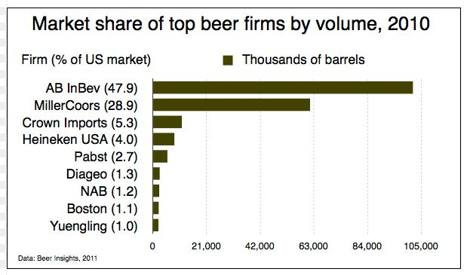
The Problem
Craft breweries, which consumers now crave, are locked out of main distribution channels.
Large breweries and distribution companies dominate the market.
95% of bars are restricted from amplifying their beer selection. Many of these are under contract from large beer producers and distributors who refrain them from amplyfying their beer selection.
Supermarkets which require higher volumes are unable to work with craft breweries due to a mismatch between offer and supply.

Slide 5
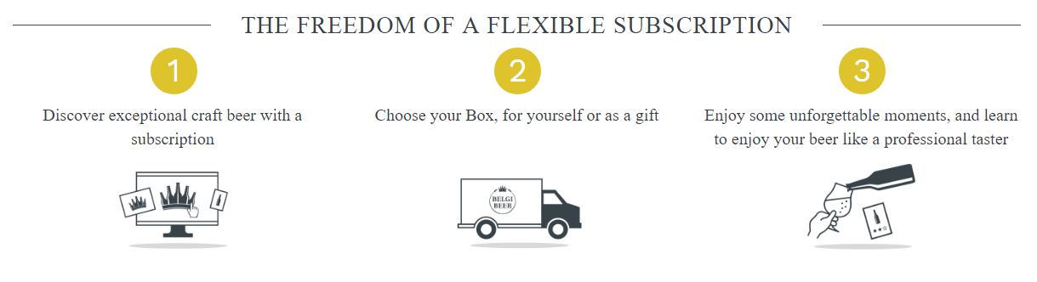
The Solution
An internet based subscription model, delivering monthly beer packages directly to beer lovers.
Beers are freshly picked from craft breweries and repackaged at Belgibeer’s warehouse.
Subscribing customers receive a box with 8 rare beers, Golden Hops magazine and a free gift.
Cross sales of additional products.
Two offerings: perpetual subscriptions and one-off (multi-month) purchase, usually gifts.

Slide 6


Mission and Vision
Allow beer lovers to easily access craft beers that are otherwise absent from the market.
Mission
Become the preferred European interaction channel between small breweries and beer lovers; the go to place for people who want to discover new beers, and for breweries who want to become famous.
Vision

Slide 7
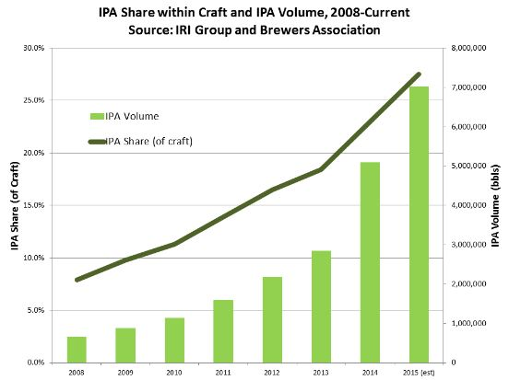
Why now?
Since the years 1990s (in America) and 2000s (Europe) there has been an exponential growth in craft beers.
Demand for craft and more organic beers has never been stronger.
The e-commerce phenomenon experienced exponential growth at the turn of the century (eg. Amazon) and solid and cheap logistics were established as a result.

Slide 8
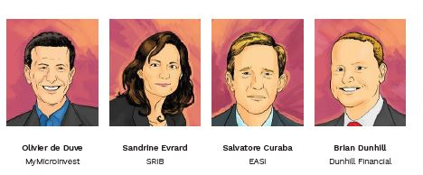
Traction Belgibeer
Turnover doubles every year.
Previously raised funding with Mymicroinvest, EASI, SRIB and business angels.
Profits reinvested into Belgibeer to improve offer to clients.
Internally developed code to better respond to clients needs and fully reflect SEO creteria.
Created a very first edition of Golden Hops Magazine to better suit client’s needs and increase revenues.
Implemented vital growth hacking techniques, more to follow in 2017 and 2018.
Project has been validated by sales.
26,000
Total Shipped Boxes
48
Total partnerships with breweries to this day April 2017
15
Total number of countries we have shipped to
Our major investors:

Slide 9
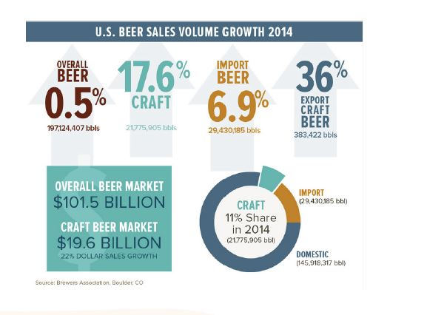
The Market
100 Bilion dollar market a year for the US alone.
20% of all beer production in the US was craft beer and it is growing fast .
Growing movement in the past few years for organic and craft products.

Slide 10



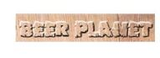




The Competition
Strong content and local identity
Modern and innovative concepts
Curated Selection
Traditional e-commerces are located here. No real value, no innovation
Customer Picks
Plain seller

Slide 11
Belgibeer dual offering – Each feeding the other
One off multi-month subscription.
Perpetual Subscriptions
Begibeer’s traditional offering.
Customer purchase 1,3,6 or 12 months subscriptions.
All boxes contain 8 beers, 1 Golden Hops magazine + a gift.
Can add extras to their order (beer glasses, food products..)
No automatic renewal at the end of period (BUT MANY CUSTOMERS RETURN BY THEMSELVES).
New Offering launched in December 2016
Customer subscribes and receives a beer box for an indefinite period.
Goes on until customer cancels or pauses.
One monthly price : 23, 90€
3.5 months
Average order duration
51.4
€
Average order value
33
%
Returning cutsomers

Slide 12
One off subscription - Stats
Distribution Countries
Average Order Content
Aquisition channels
Subscription duration (%)

Slide 13
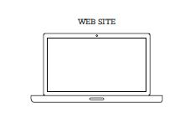
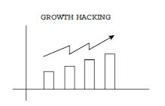
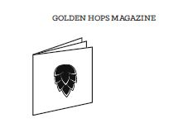
Go to Market and Sales Strategy
Aquisition channels
Web site
In April 2017 a more professional design to elevate the perception and level of our concept.
Gamification: allowing our customer to interact with our platform and earn points. Points can then be exchanged for items on our web platform.
Data: Collecting data to better know our clients and automate specific offerings.
Growth Hacking
Customer Service
Referrals
Targeted emails and private sales.
Golden Hops Magazine
New Magazine to cover beer news
Included in all boxes and newspaper (60K copies)
Sponsored and general articles in the beer world.
Direct Aquisition Cost
Google
Facebook
Affiliates
6 €
Web Sites visits and converstion rates
7500 site visits /month
2,7% are converted into clients

Slide 14
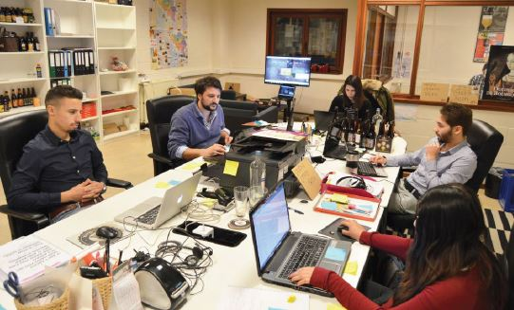
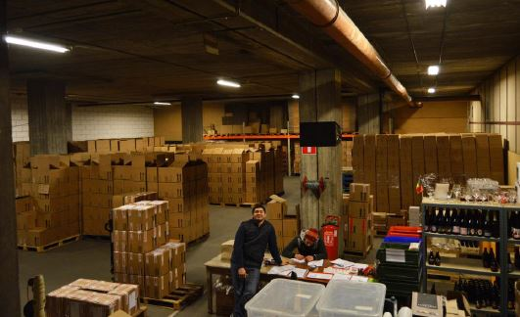
Belgibeer: Office and Warehouse under the same roof
Office work : Marketing, Magazine, Customer Service, IT.
Warehouse: fulfilment.
Thousand of boxes leave our warehouse every month. The delivery of our beerboxes is subcontracted to DPD, Mondial Relay and Belgian Postal Services.

Slide 15
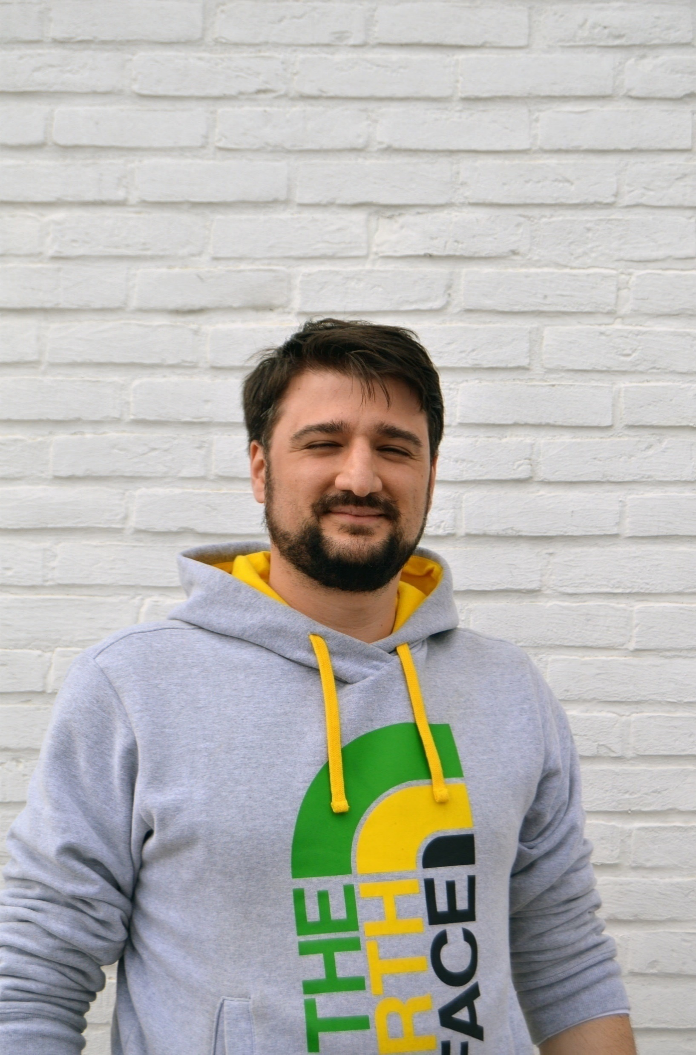
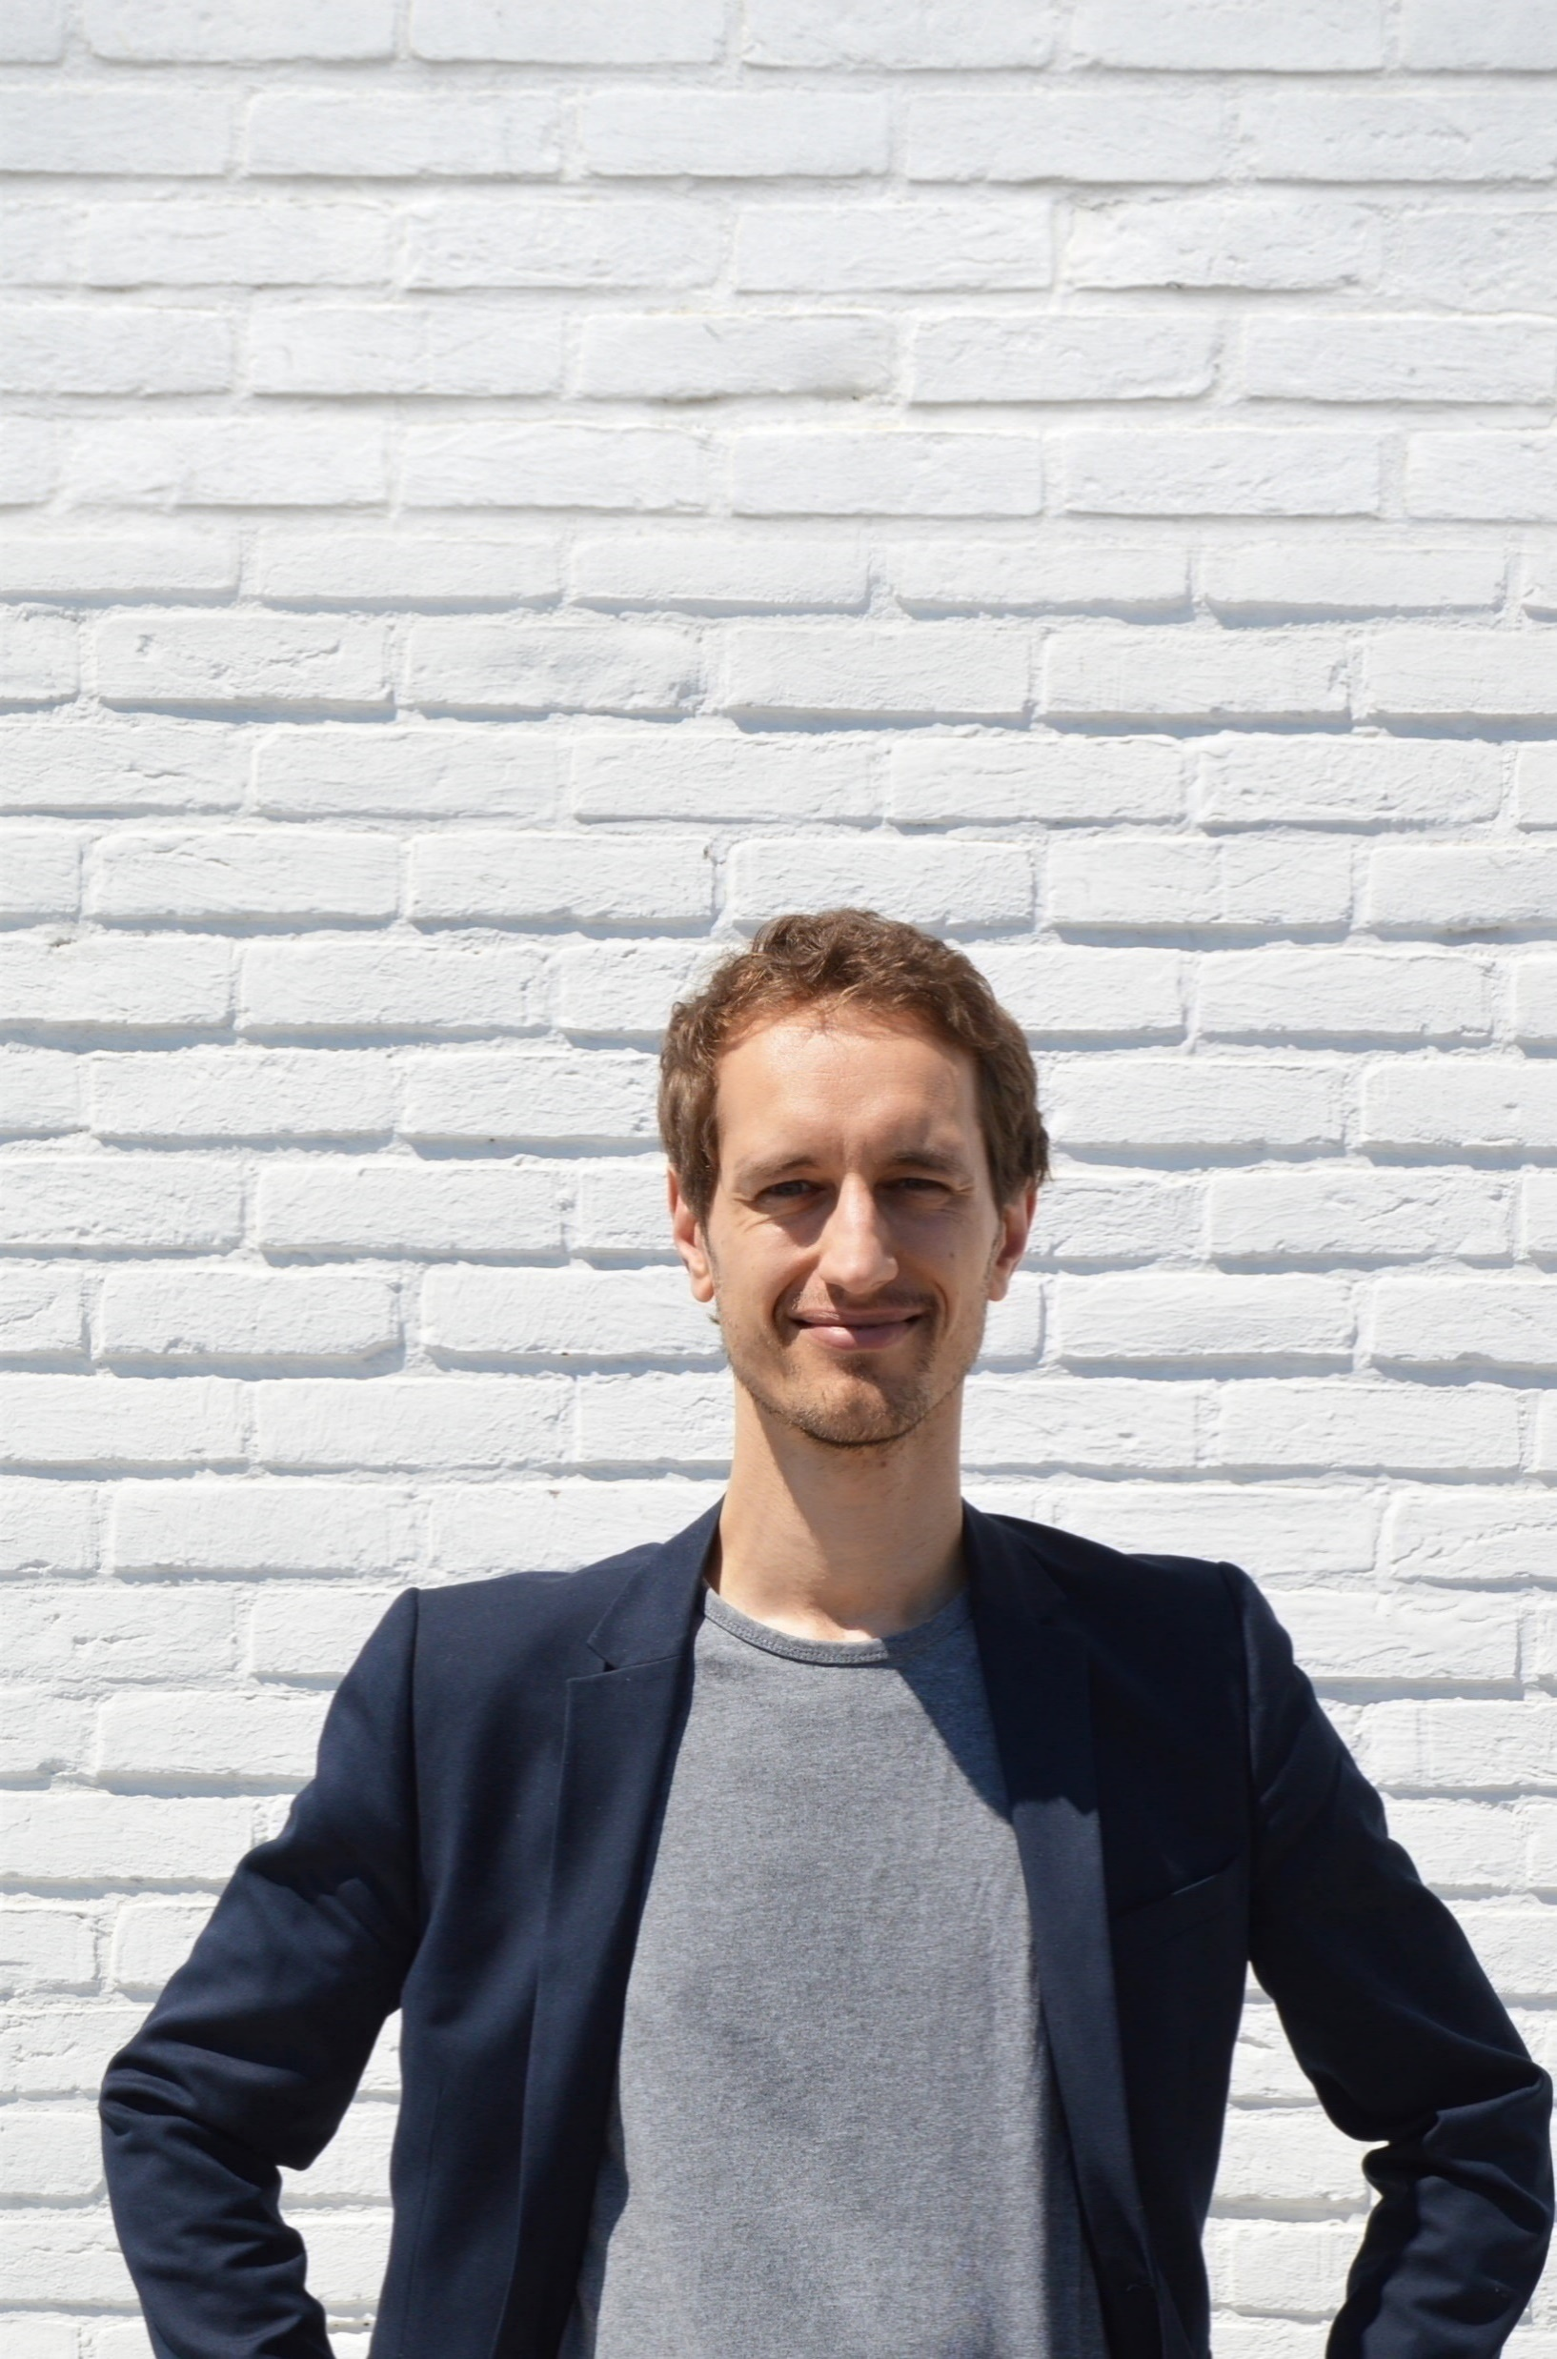
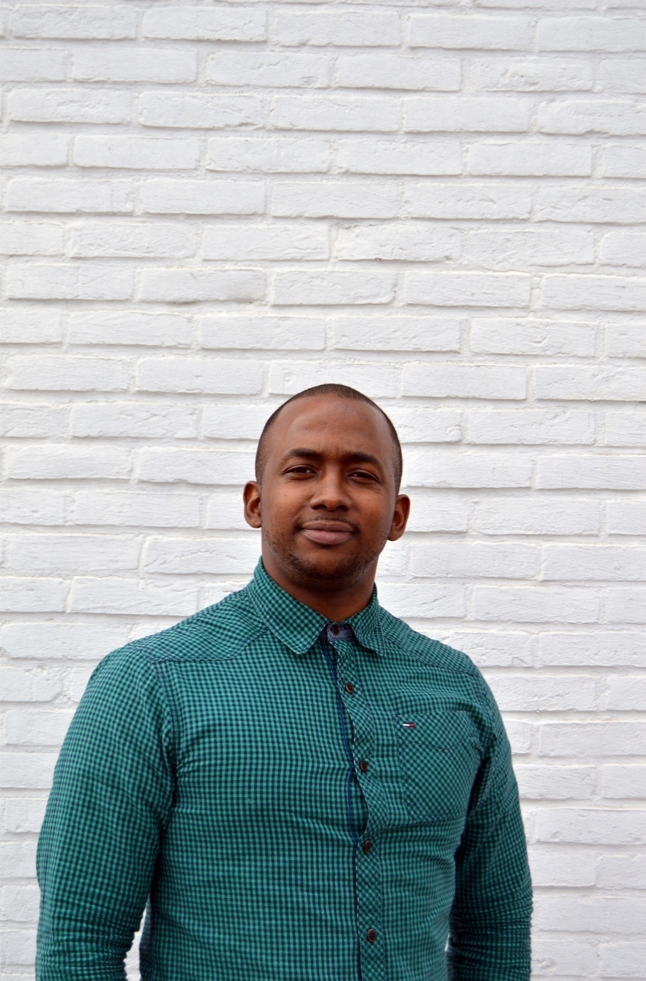
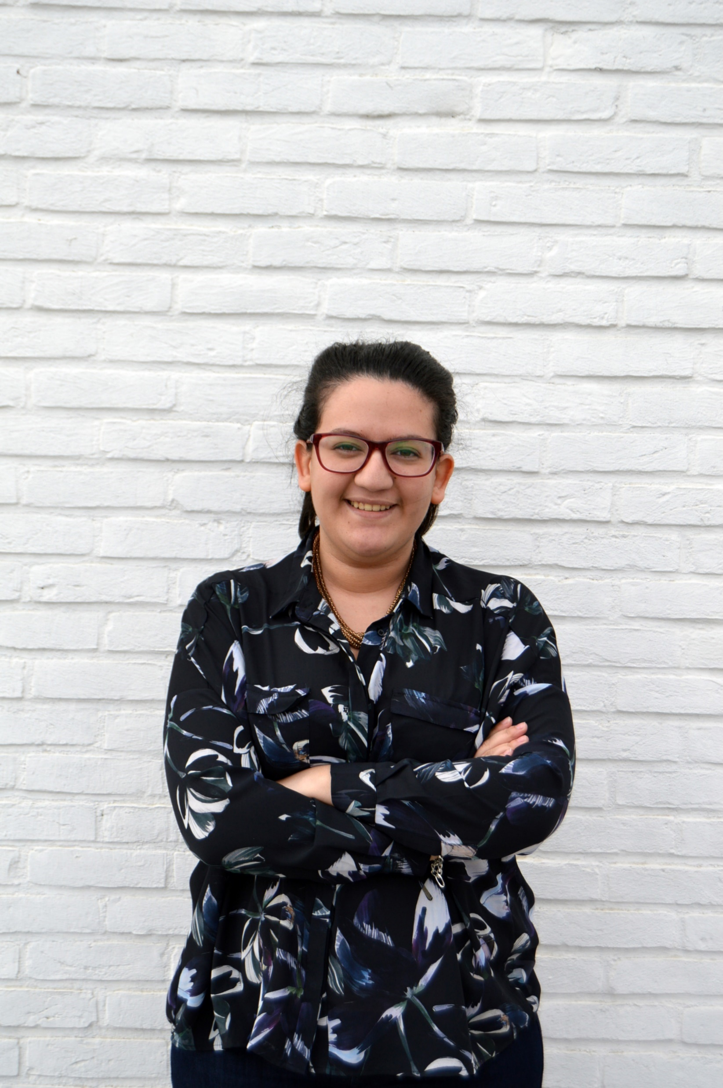
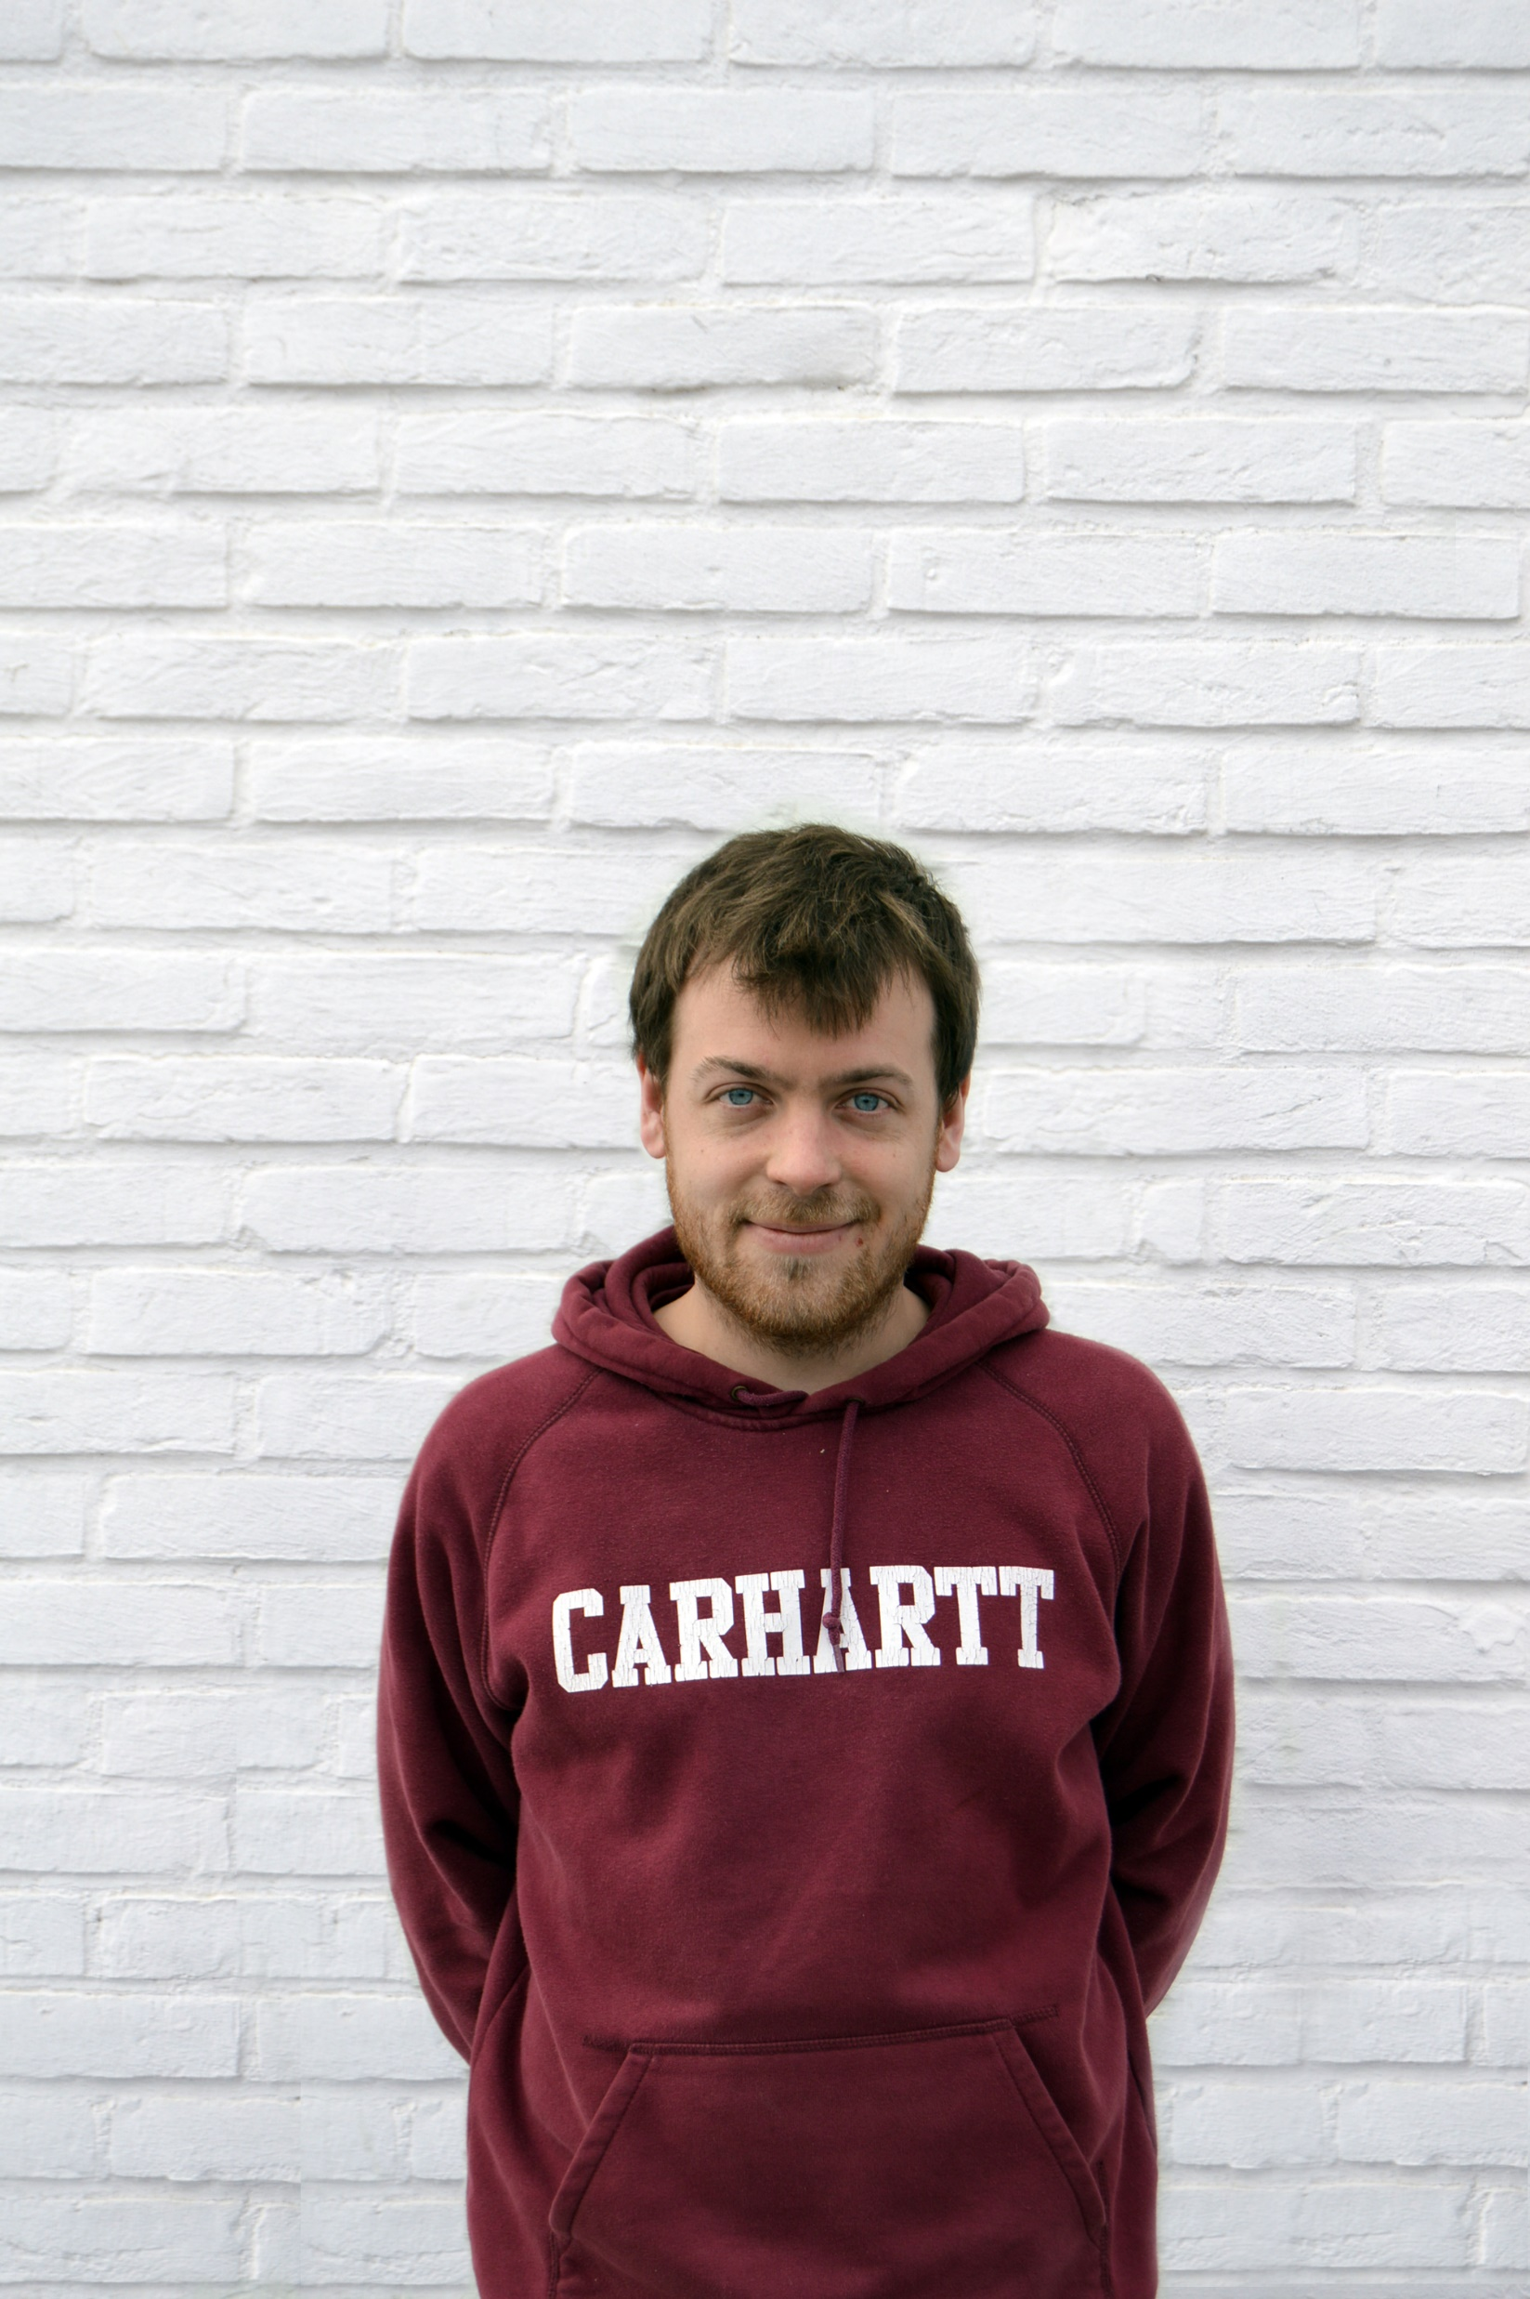
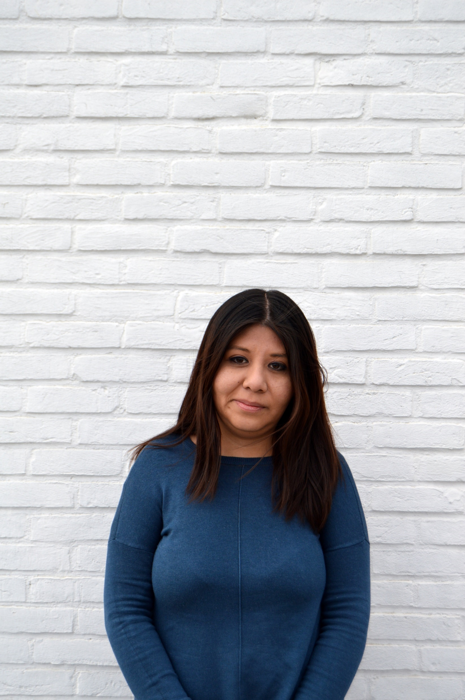
The Team
Dario Ceccarelli
Paul Pilavachi
Barry Abdoulye
Soraya M’Rini
Loic Versichel
Esthefany Tocas
CEO and co-founder
co-founder and CTO
Project Manager
Marketing Manager
Design
IT
Lorenzo Solari – External Financial Advisor (former CFO @ Real Impact Analytics, raised 12M in 2016)
Oceane Fegé – Intern Journalist
Salvatore Curaba – Lead Investor, CEO at EASI Belgium’s best employer 2015, 2016 et 2017

Slide 16
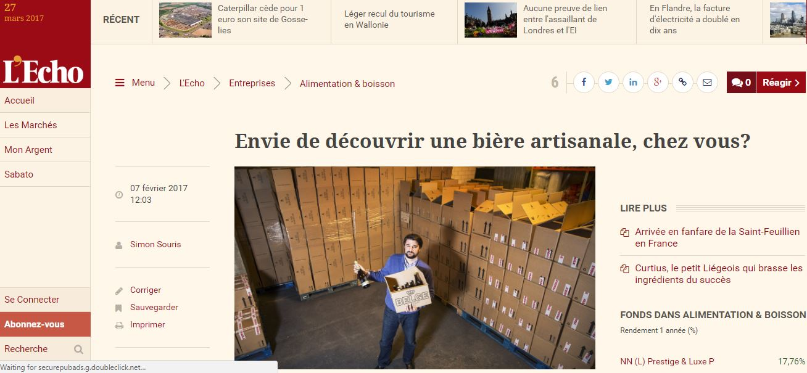
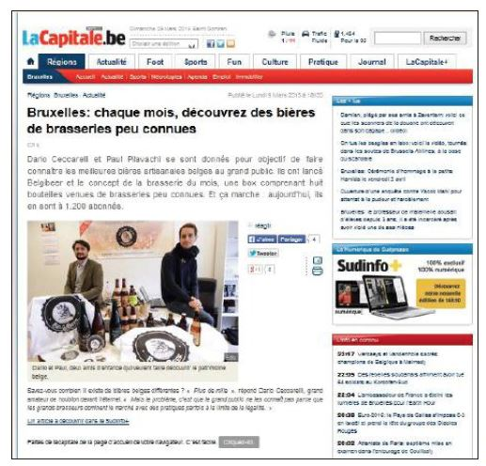
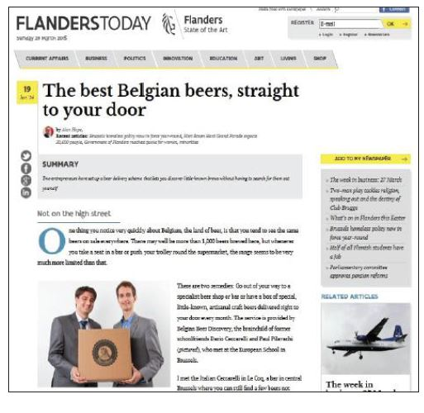
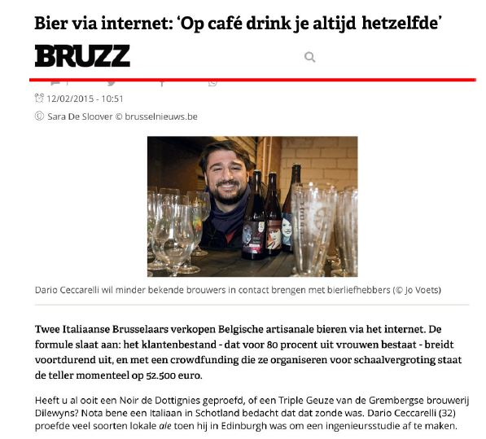
Belgibeer and the press

Slide 17
Historical Financials and Business Plan
Strong revenue growth expected from recurring subscriptions, which are expected to overtake one-off subscriptions in 2018, and become the biggest contributor to revenue by far in 2019.
Disappointing revenue decrease in 2016 was due to new website (now changed – see other slides) which had very poor SEO and conversion scores
Gross profit expected to gradually increase back to historical levels, and even slightly higher as negotiation power increases with volumes
2016 Gross Margin was low purely as an effect of revenue decrease
Significant operating loss in 2017 due to
High investments in sales & marketing to support growth (CAC expected to reach 80-100€ post fundraising, from approx. 50€ now)
Initially low gross margin from magazine and other initiatives
Positive cash flow expected from 2018 as revenue increases and growth margin climbs back to normal levels

Slide 18
Use of Funds
We are raising:
600k€
Use of proceeds:
Aggressive marketing push
Increase CAC from approx. 50€ to 80€ to support client acquisition of the new recurring subscriptions.
Expand to under exploited (but already active) geographies (UK, NL, DE)
Investments in technological platform to
Improve retention through better analytics, gamification and referral systems.
Improve robustness and automation.
Sustainability until profitability.

Slide 19
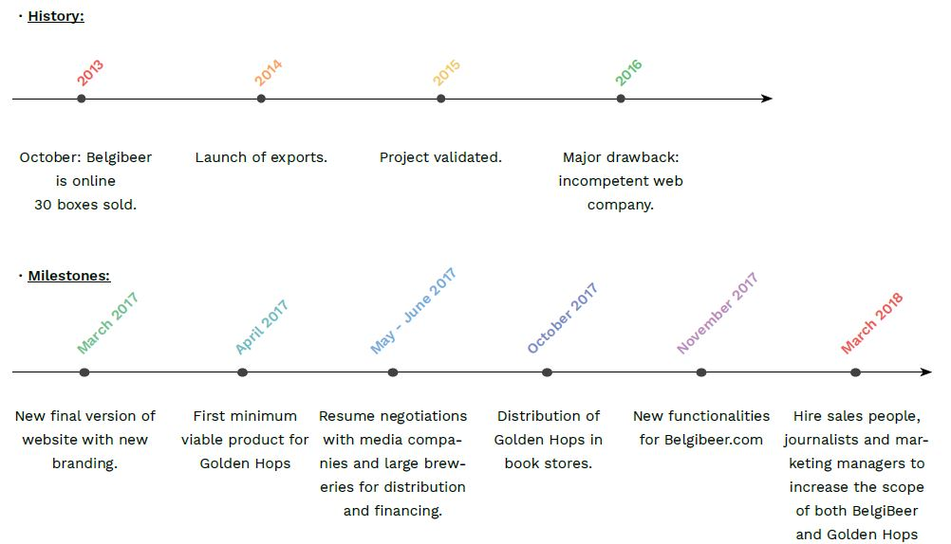
History and Milestones

Slide 20
Key Investments Highlights
Huge Market
Clear Traction
Proven ability to deliver
Clear path to profitability
Any questions?

